Slide 1
ggplot2
CSCI 444

Slide 2
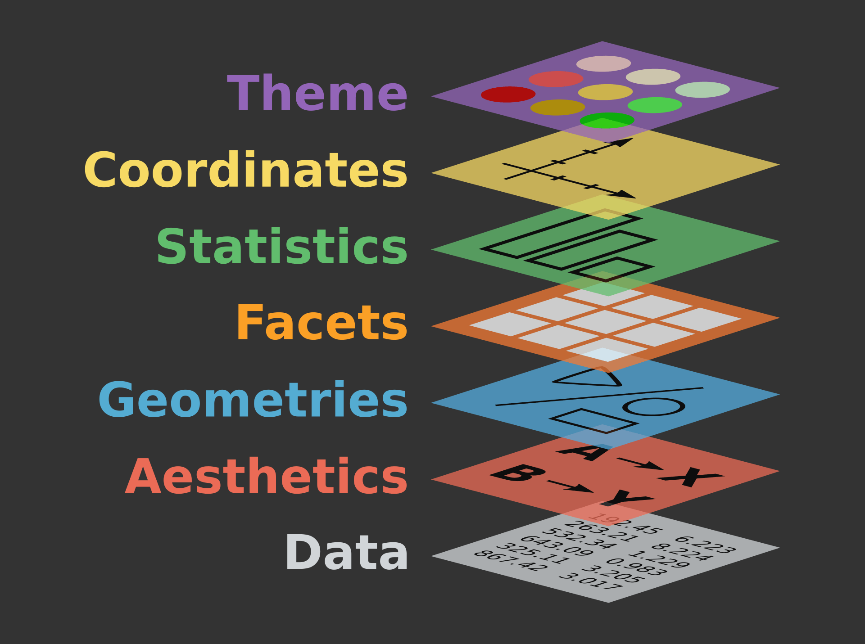
Grammar of Graphics
Leland Wilkinson coined term
  Separate what is graphed from how it is graphed
Grammar of Graphics
  Data
  Aesthetic mapping
  Geometric object
  Faceting
  Statistical transformations
  Scales
  Coordinate system
  Position adjustments

Slide 3
dplyr → %>% transforms data
ggplot → + layers data visualization
Aesthetic | Descripton
x | x-value
y | y-value
shape | Type of point
color | Color of point
fill | Fill of point
size | Size of point
alpha | transparency
Example – Baseball Team’s Wins
  Data: baseball wins
  Geometry: Point → geom_point
  Mappings → Aesthetics:
    x = year
    y = wins
    color = Team

Slide 4
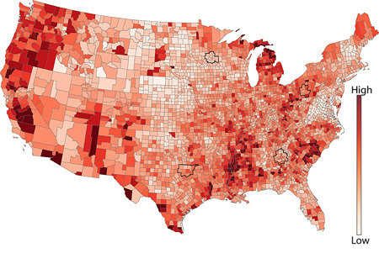
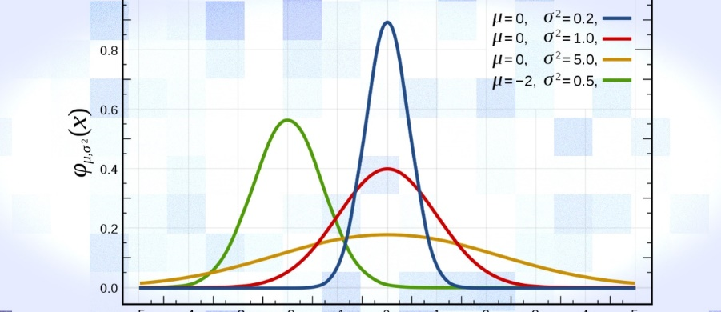
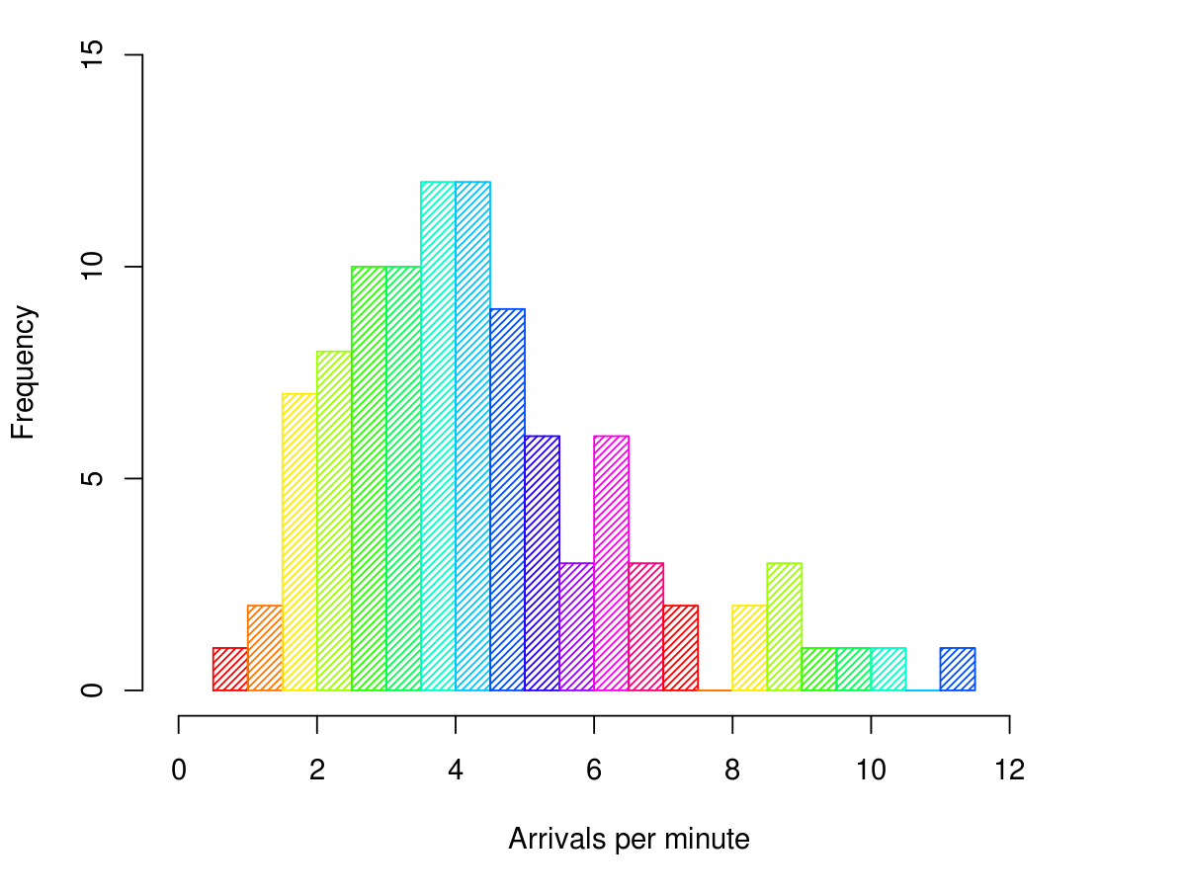
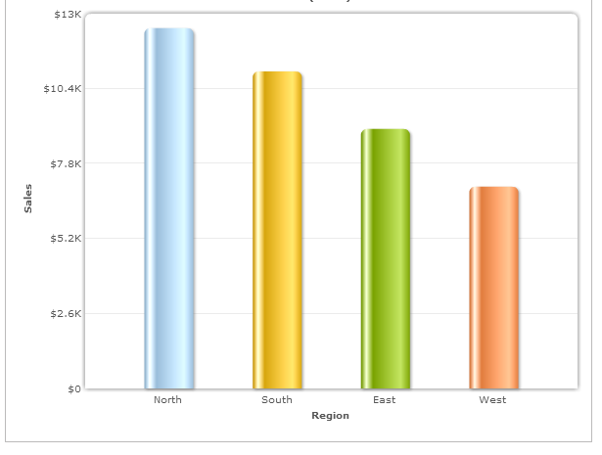
Geometrical Object
    geometrical object → geom_<obj>(mapping = aes(<MAPPINGS>),
    stat = <STATS>,
    position = <POSITION>)
geom defines plot
  scatterplot
  scatterplot with smooth
  line chart
  column chart
  boxplot
  bar chart
  histogram
  And more …
statistical tranformation

Slide 5
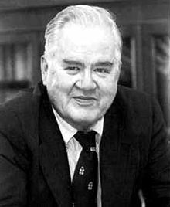
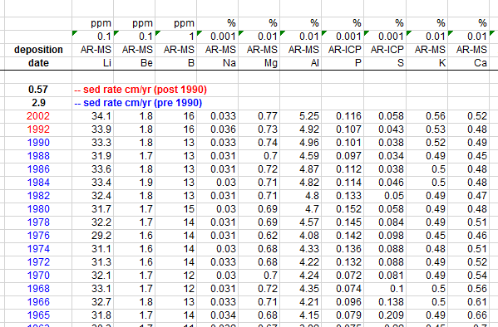
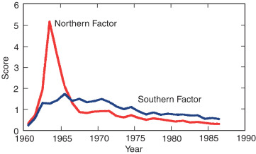
Mapping
John Tukey
  The greatest value of a picture is when it forces us to notice what we never expected to see.
Mapping
  Defines how data maps to visual properties
  aesthetics function
Mid-1960s H-Bomb testing
³H produced as fission by-product
https://www.sciencedirect.com/topics/earth-and-planetary-sciences/tritium

Slide 6
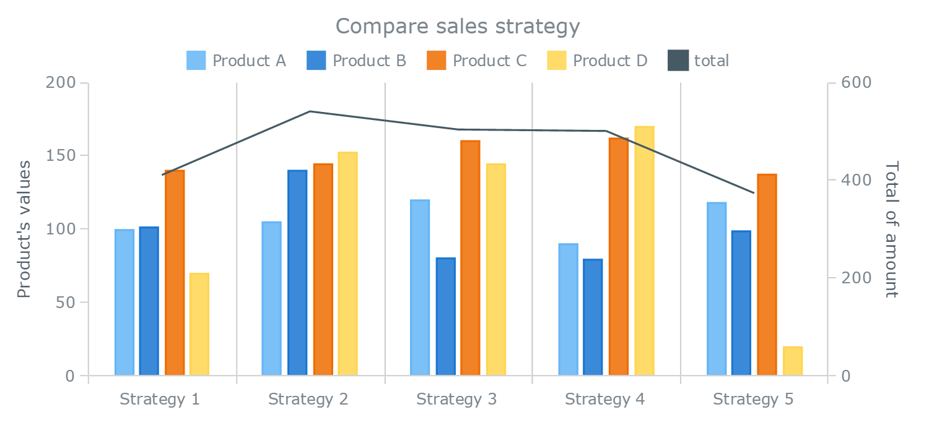
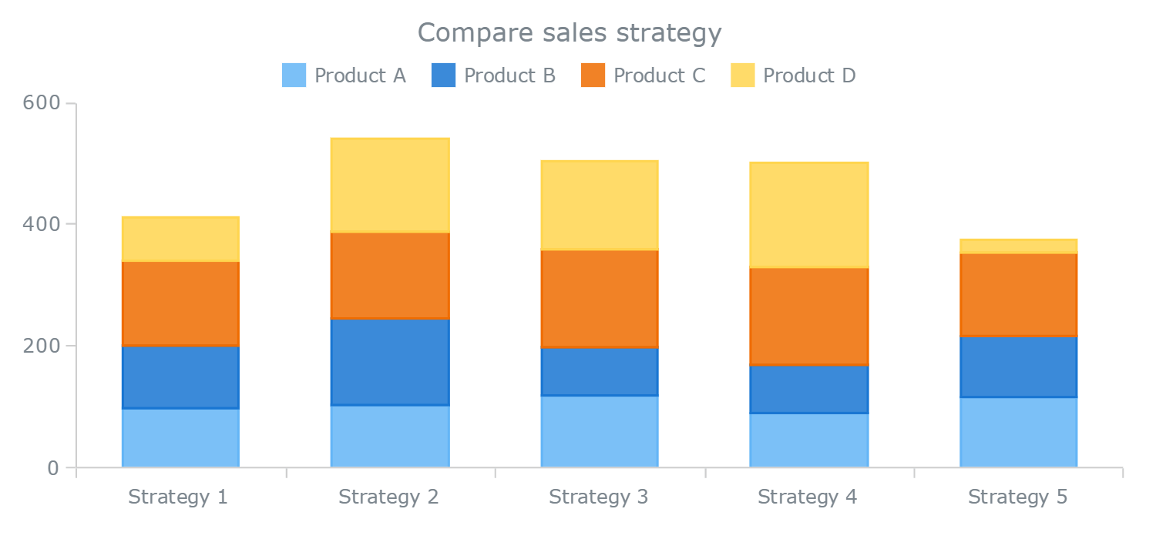
Mapping
Statistical Transformation
  Uses variables to plot
Position
  Depends on geom_object
    bar → dodge displays side-by-side
    → fill displays stacked bar
    with bars same size
    → stack displays a stacked bar
    point → jitter displays random “noise” in point placement

Slide 7
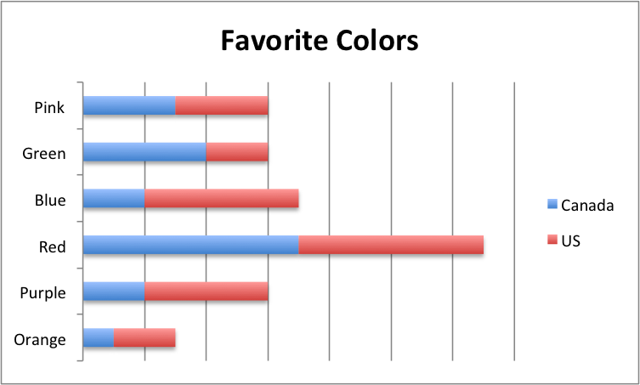
Coord_
coord_
  Defines coordinate system/attributes
  coord_polar → polar coordinates
    Cartesian coordinates default
  coord_flip → flips axes
  coord_quickmap() → geospatial viz
    coord_map()
    coord_map(projection = “albers”)

Slide 8
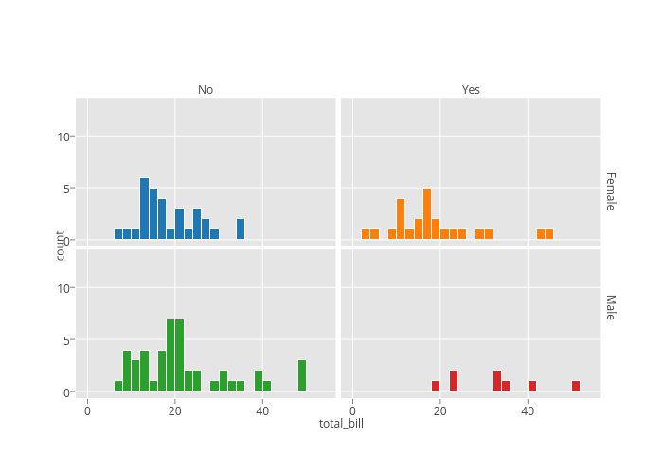
Facet_
facet_
  Divides plot into subplots based on DISCRETE variables
facet_wrap() → rectangular layout
facet_grid() → grid of rows and columns

Slide 9
Scale_
scale_
  Defines attributes for scales
Specify discrete or continuous
  scale_color_
  scale_size_
  scale_x_
  scale_y_
Discrete
  scale_fill/color_brewer(palette= “name”)
Continuous
  scale_fill/color_distiller(palette=“name”)
  scale_fill_gradient(low=“color1”,
  high=“color2”)
  scale_fill_gradient2 → specify middle color
  scale_shape_ & scale_size_

Slide 10
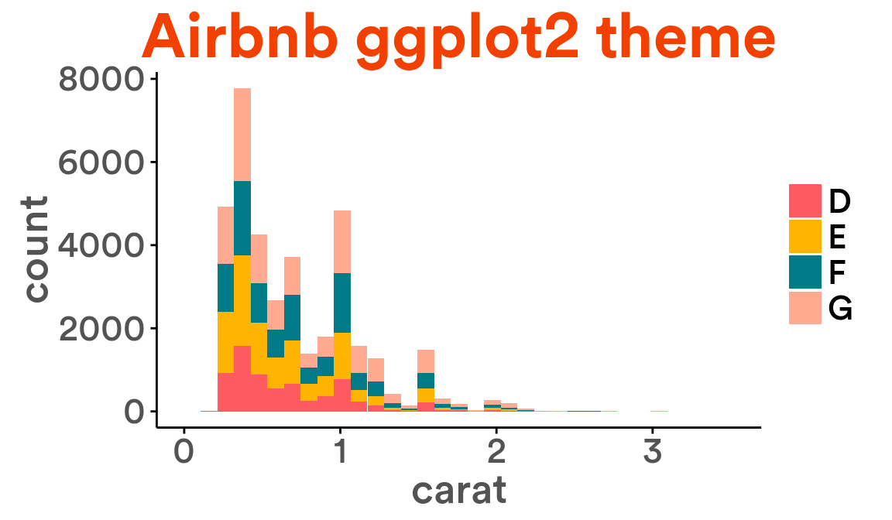
Labels & themes
labs → defines labels
  x =
  y =
  title =
  subtitle =
theme_ → defines color theme
→ defines legend position

Slide 11
Using Color Brewer As A Layer
Discrete/Categorical – histogram, bar chart & column chart (sometimes)
  scale_color_brewer(palette = “name”)
  scale_fill_brewer(palette = “name”)
  direction = -1 reverses color
Continuous – scatterplot, line, & column chart (sometimes)
  scale_color_distiller(palette = “name”)
  scale_fill_distiller(palette = “name”)
  NOTE: direction = -1 → DOES
  NOTHING
  transform = “reverse” reverses color

Slide 12
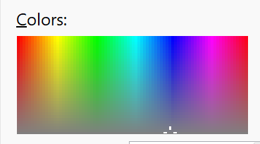
Using Color Brewer as a Layer
May also use gradient or gradient2 functions
  gradient color is low to high and passes through white
  scale_fill_gradient(low=“blue”, high=“red”, na.value = “yellow”)
  gradient2 color is low to high, passing through a middle color defined in the function
  scale_fill_gradient2(low=“green”, mid = “gray”, high=“yellow”, na.value =“white”)
May also manually set colors
  myColors <- palette(brewer.pal(6, “Blues”))
  scale_color_manual(values = myColors)

Slide 13
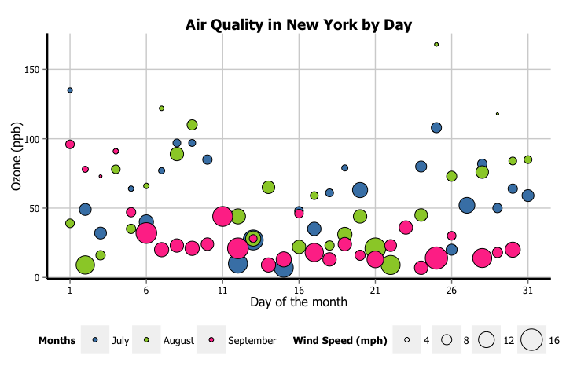
Scatterplot
TWO CONTINUOUS values
geom_point → plots (x, y) values
  Minimum: define x & y
Aesthetics
  x, y
  color, fill
  alpha, shape, size, stroke

Slide 14
Scatterplot – Example
  Download college.csv file and mutate
  Convert FIVE variables to factors
    state
    region
    highest_degree
    control
    Gender
  Convert ONE variable to numeric
    loan_default_rate
college <- read_csv("college.csv", col_names = TRUE)
college <- college %>%
mutate(state = as.factor(state),
region = as.factor(region),
highest_degree = as.factor(highest_degree),
control = as.factor(control),
gender = as.factor(gender),
loan_default_rate = as.numeric(loan_default_rate)) %>%
na.omit

Slide 15
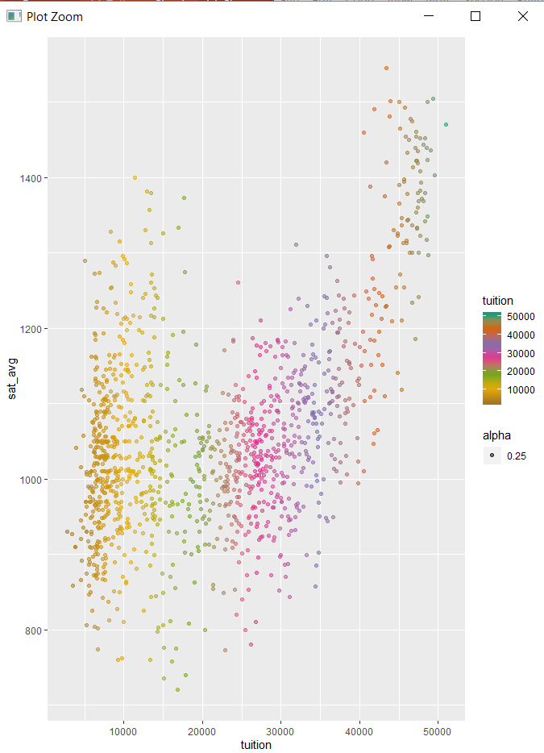
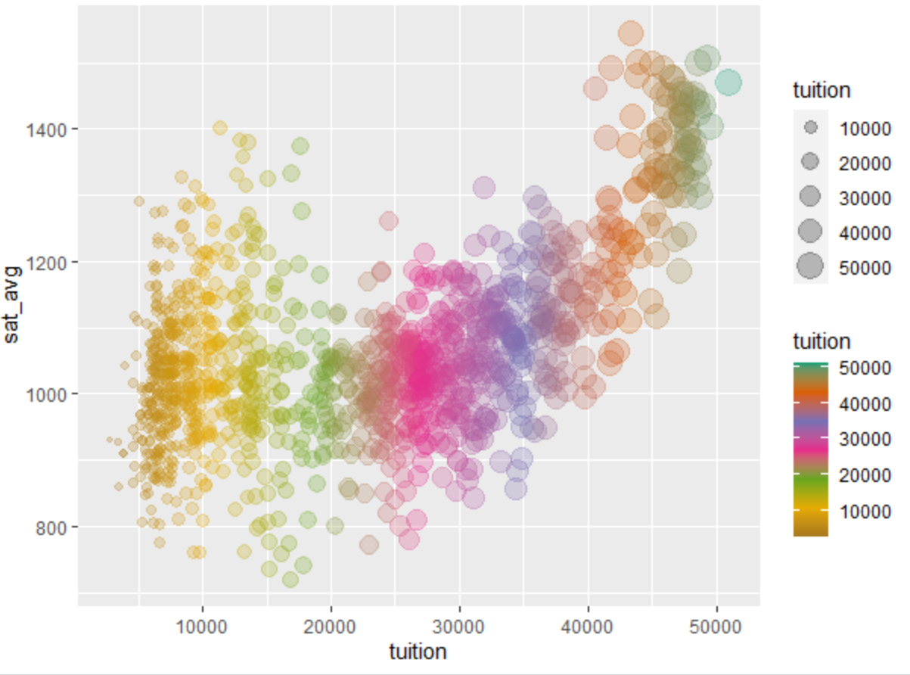
Scatterplot Example – con’t
Use aesthetics
college %>%
ggplot() +
geom_point(mapping = aes(x=tuition,
y=sat_avg,
color = tuition,
alpha = 0.25)) +
scale_color_distiller(palette="Dark2")
What happens when the size aesthetic is used?
  Size by tuition

Slide 16
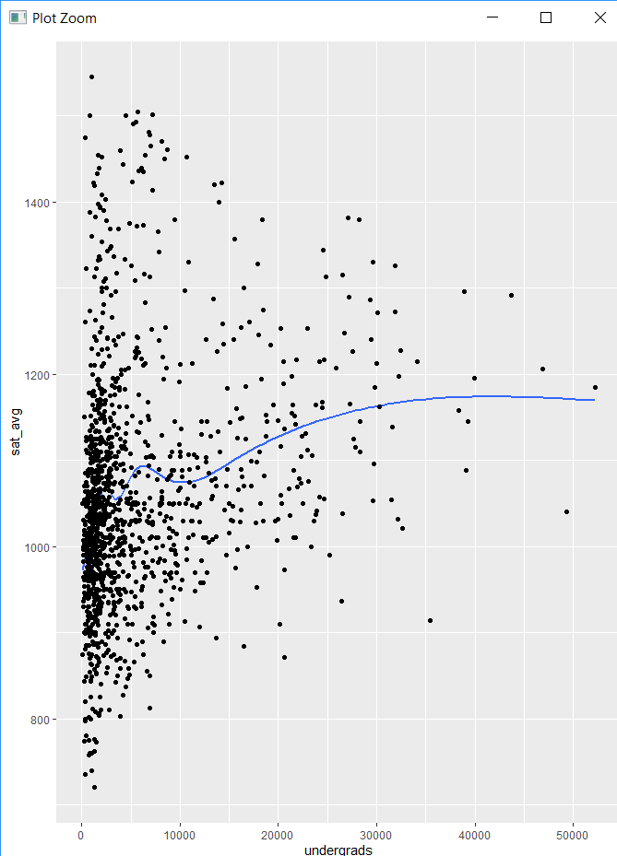
Scatterplot Example – con’t
college %>%
ggplot(mapping = aes(x = undergrads,
y = sat_avg)) +
geom_smooth(se = FALSE) +
geom_point()

Slide 17
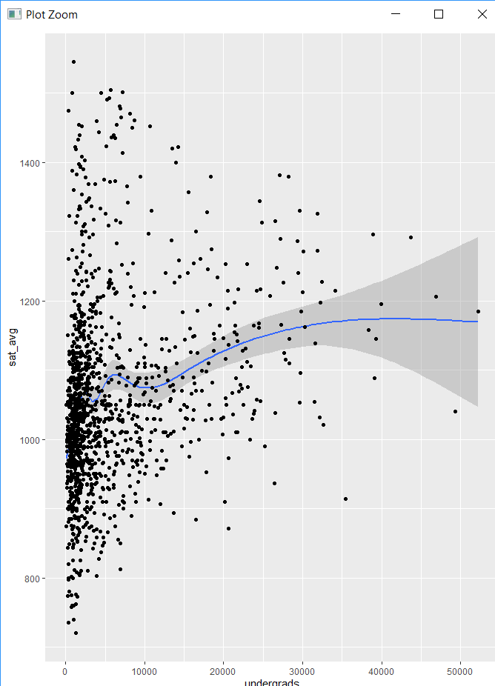
Scatterplot Example – con’t
se → standard error
  The standard error is the approximate standard deviation of a statistical sample population.
  The standard error is a statistical term that measures the accuracy with which a sample represents a population.
  In statistics, a sample mean deviates from the actual mean of a population; this deviation is the standard error.
  Common methods in r
    method = "lm" → linear model (regression line)
    method = "loess" → local estimated scatterplot smoothing (aka local regression)

Slide 18
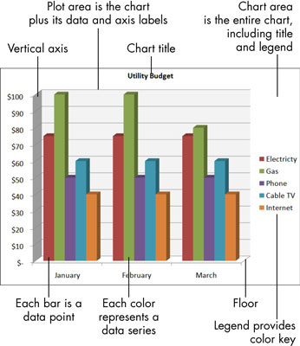
Beautifying Your Visualization
theme layer modifies plot display
  plot.background → rectangle of plot area – plot on top of this
  panel.background → chart area – rectangle
  panel.grid.major & panel.grid.minor → grid lines
  axis.text, axis.title, axis.ticks → tick mark attributes
To remove element → assign element_blank()

Slide 19
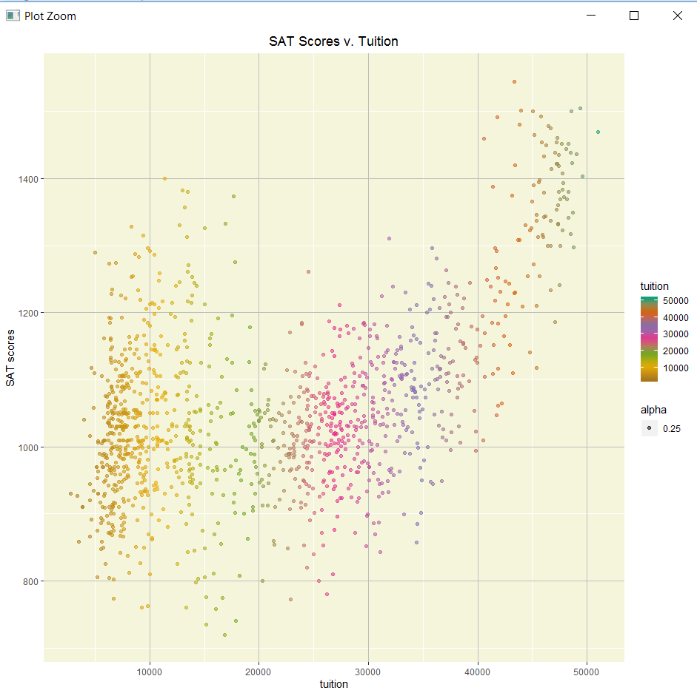
Example
college %>%
ggplot() +
geom_point(mapping = aes(x=tuition,
y=sat_avg,
color = tuition,
alpha = 0.25)) +
scale_color_distiller(palette="Dark2") +
theme(panel.background = element_rect(fill = "beige"),
panel.grid.major = element_line(color = "gray"),
plot.title = element_text(hjust = 0.5)) +
labs(title = "SAT Scores v. Tuition") +
ylab("SAT scores")
Centers title

Slide 20
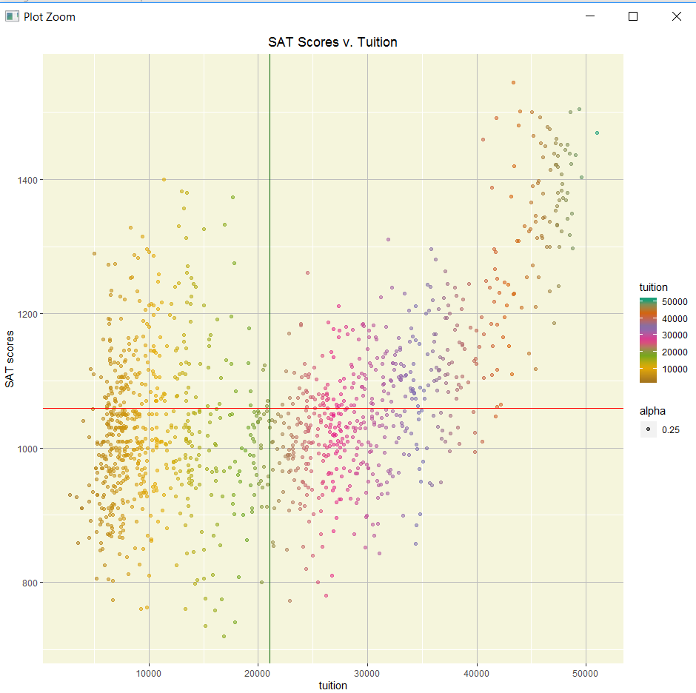
Vertical & Horizontal lines
geom_hline(yintercept = num)
geom_vline(xintercept = num)
geom_hline(yintercept=mean(college$sat_avg), color="red") +
geom_vline(xintercept=mean(college$tuition), color="darkgreen")

Slide 21
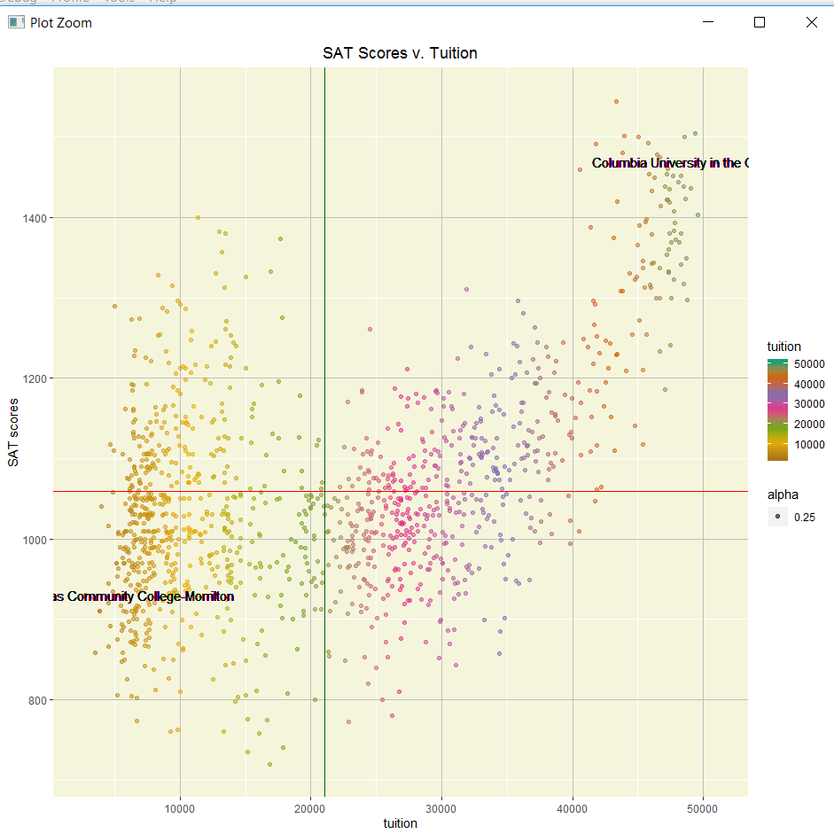
Text
geom_text(mapping = aes(x= ,y = , label = )
nudge_x & nudge_y slightly moves text
maxSchool <- college %>%
filter(tuition == max(tuition))
minSchool <- college %>%
filter(tuition == min(tuition))
geom_text(mapping=aes(x=maxSchool$tuition, y=maxSchool$sat_avg, label=maxSchool$name), nudge_x=-5) +
geom_text(mapping=aes(x=minSchool$tuition, y=minSchool$sat_avg, label=minSchool$name),
nudge_x = 4)

Slide 22
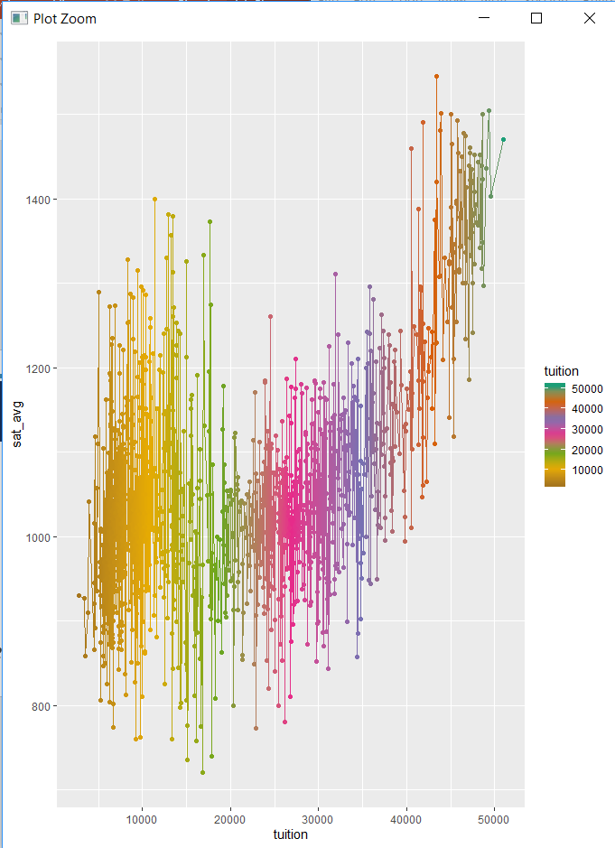
Line Chart
Continuous (time-series)
  geom_line → connects point to a line
  group_by → plots a line for each group
College example
  Add line layer – What does the graph look like?

Slide 23
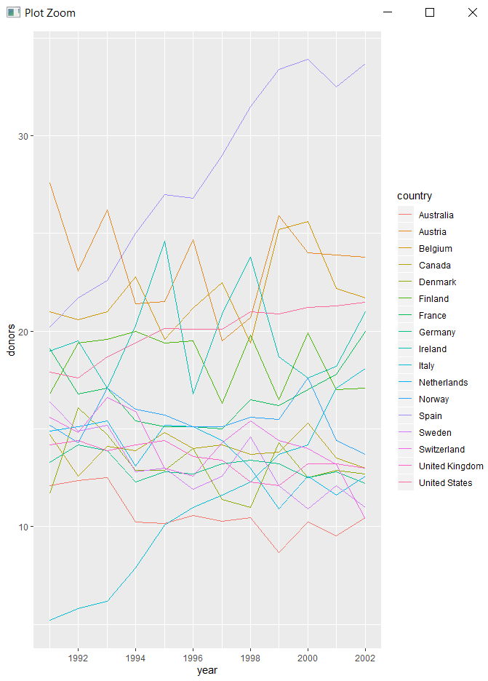
Line Chart – Example
organdata dataset in socviz package
organdata %>%
ggplot(mapping = aes(x = year, y = donors)) +
geom_line(mapping = aes(group = country, color = country))
organdata %>%
group_by(country) %>%
ggplot(mapping = aes(x = year, y = donors)) +
geom_line(mapping = aes(color = country))

Slide 24
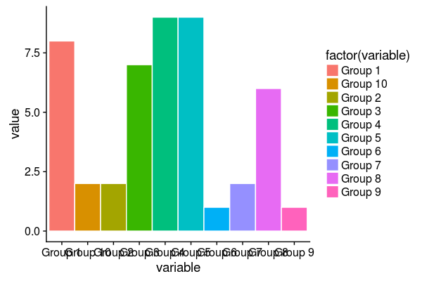
Column Charts
ONE DISCRETE/CATEGORICAL (x) & ONE CONTINUOUS (y)
geom_col
geom_col() + coord_flip() → best for Bar Charts
Aesthetics
  x, y, alpha, color, fill, group, linetype, size
  fill → colors in columns
  guides(fill = “none”) → does not print legend
  facet_wrap(~var) → displays each var as its own chart

Slide 25
Column Charts – Example 1
crimes <- read_csv("crimes.csv", col_names = TRUE)
crimes2016 <- crimes %>%
filter(YEAR == 2016) %>%
group_by(OFFENSE_CODE_GROUP)%>%
count() %>%
arrange(desc(n))
crimes2016 %>%
ggplot() +
geom_col(mapping = aes(reorder(x = OFFENSE_CODE_GROUP, n),
y = n,
fill =OFFENSE_CODE_GROUP))+
labs(title = "Crimes in 2016")
Counts crimes & creates a column n

Slide 26
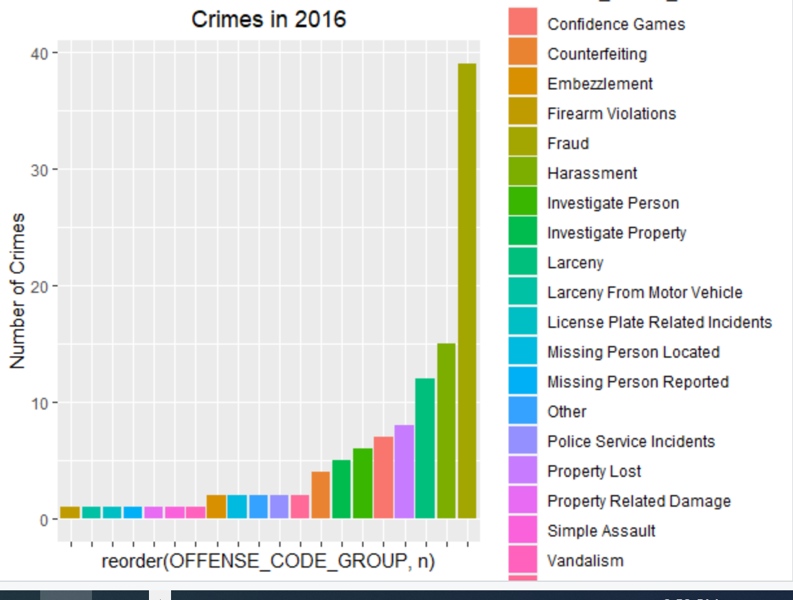
Column Charts
Example 1 – con’t

Slide 27
Column Charts – Example 2
Reorder x to list descending
  NOTE x WILL BECOME y once coordinates are flipped
Flip coordinates
Remove legend
crimes2016 %>%
ggplot() +
geom_col(mapping = aes(x = reorder(OFFENSE_CODE_GROUP, n, na.rm = TRUE),
y = n,
fill = OFFENSE_CODE_GROUP))+
labs(title = "Crimes in 2016") +
coord_flip() +
guides(fill = “none”)

Slide 28
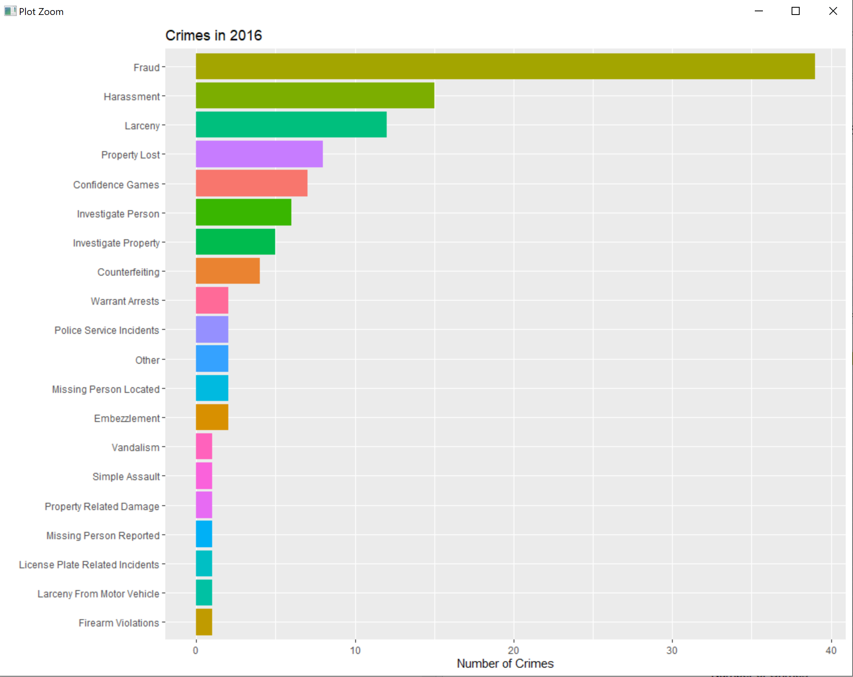
Column Charts
Example 2 – con’t

Slide 29
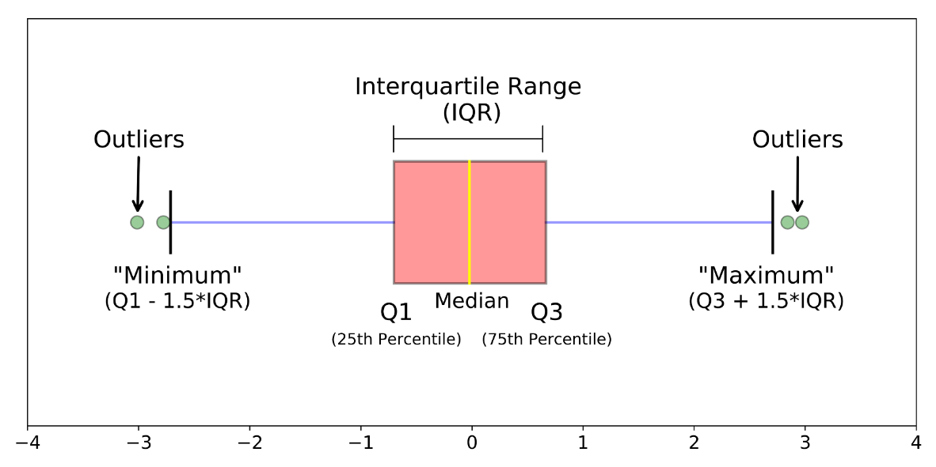
Boxplots
ONE DISCRETE/CATEGORICAL (x)
& ONE CONTINUOUS (y)
  Easily shows outliers
geom_boxplot
Aesthetics
  Same as Column Charts +
  Lower, middle, upper, ymax, ymin,
  shape, weight
Use coord_flip to modify plot

Slide 30
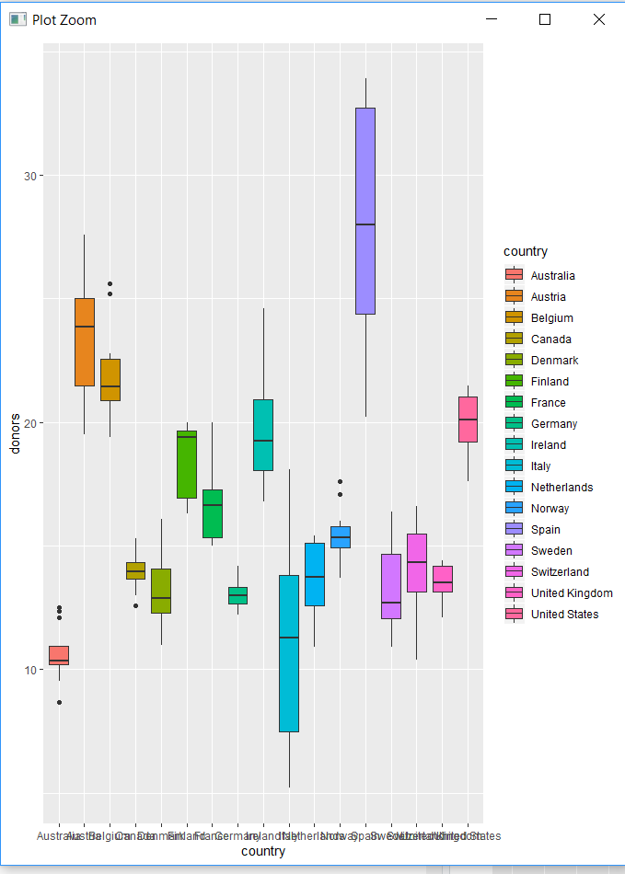
Boxplot – Example 1
  organdata %>%
  ggplot() +
  geom_boxplot(mapping = aes(x = country,
  y = donors,
  fill= country))

Slide 31
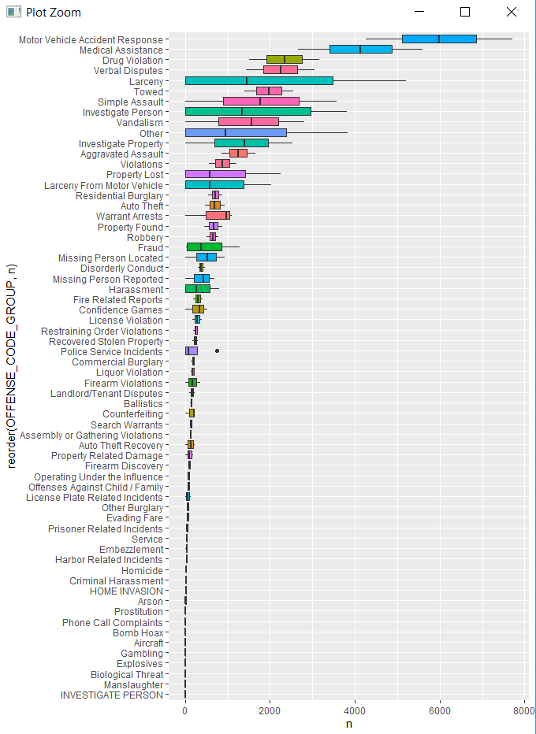
Boxplot – Example 2
  crimeTypesByYear <- crimes %>%
  select(YEAR, OFFENSE_CODE_GROUP) %>%
  group_by(YEAR, OFFENSE_CODE_GROUP) %>%
  count() %>%
  ungroup()
  crimeTypesByYear %>%
  ggplot() +
  geom_boxplot(mapping = aes(x = reorder(OFFENSE_CODE_GROUP, n),
  y = n,
  fill = OFFENSE_CODE_GROUP)) +
  guides(fill = "none") +
  coord_flip()

Slide 32
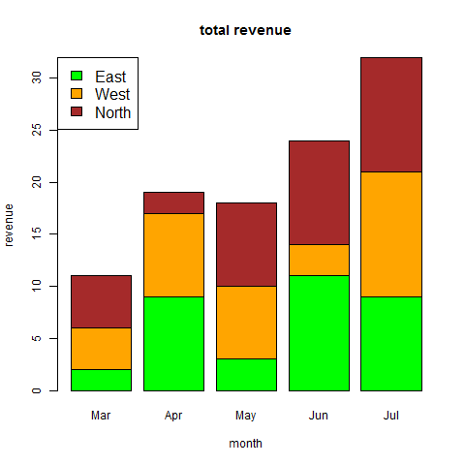
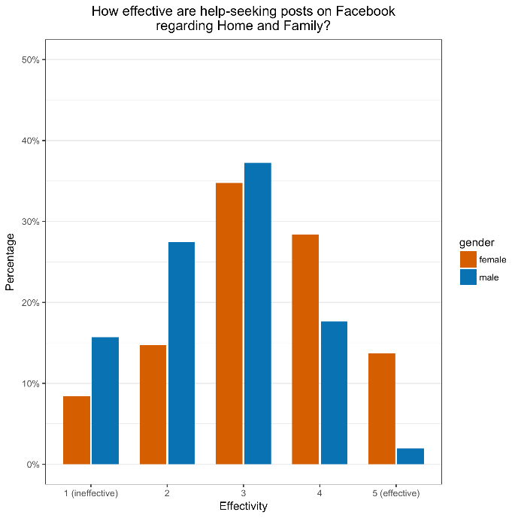
Bar Charts
ONE DISCRETE/CATEGORICAL
geom_bar
Aesthetics
  Same as Column Chart
  EXCEPT → no y
  → weight instead of bins

Slide 33
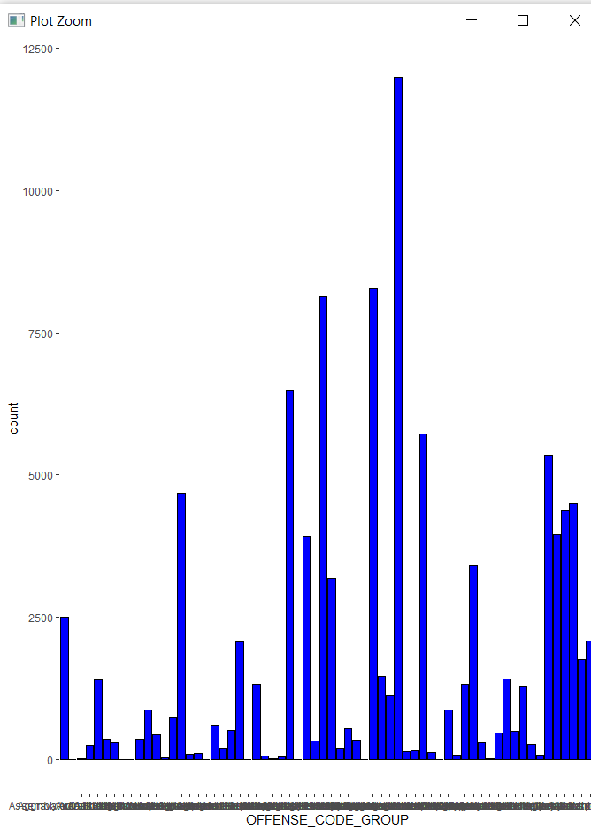
Bar Charts – Example 1
  crimes %>%
  ggplot() +
  geom_bar(mapping = aes(x=OFFENSE_CODE_GROUP),
  bins = 4,
  fill = "blue",
  color = "black") +
  theme(panel.background = element_blank())
Removes gray (default) background

Slide 34
Bar Charts – Example 2
facet_wrap
Use ~ to select variable
“by” YEAR
scales = “free” → each facet has its own scale
Can free scales individually scales = “free_y” or scales = “free_x”
ncol = 1 → sets number of columns
  crimes %>%
  filter(OFFENSE_CODE_GROUP == c("Larceny", "Vandalism", "Medical Assistance", "Fraud")) %>%
  mutate(YEAR = as.integer(YEAR)) %>%
  ggplot() +
  geom_bar(mapping = aes(x=YEAR, fill = OFFENSE_CODE_GROUP)) +
  facet_wrap( ~ YEAR, scales = "free_y") +
  theme(axis.text.x = element_blank())
Remove x-axis tick marks to prevent clutter

Slide 35
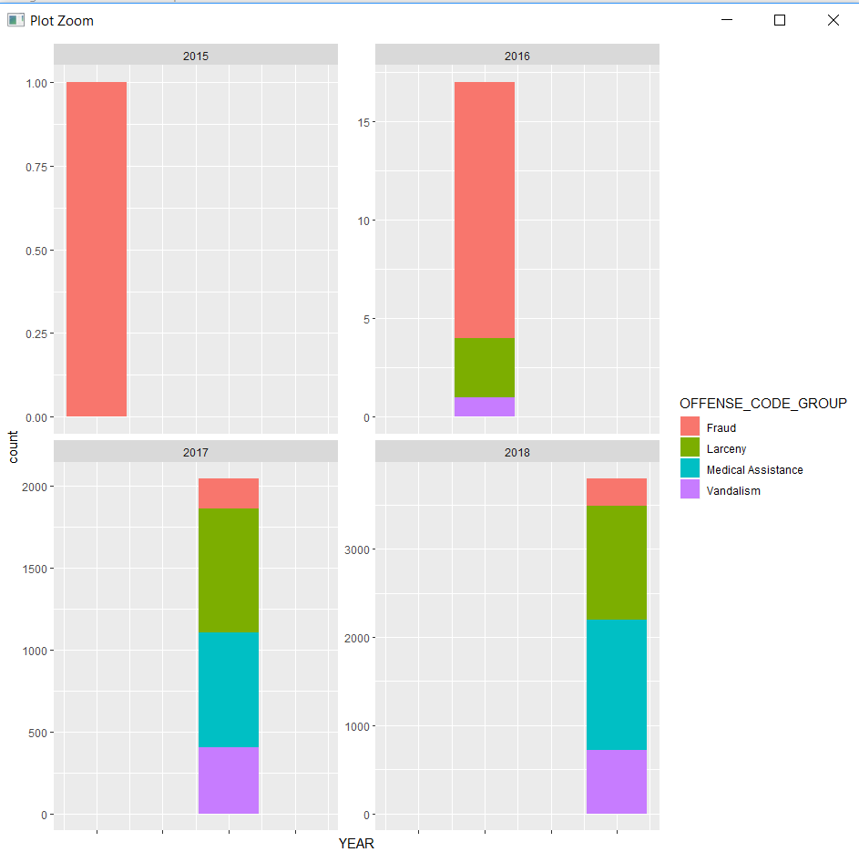
Bar Charts
Example 2 – con’t

Slide 36
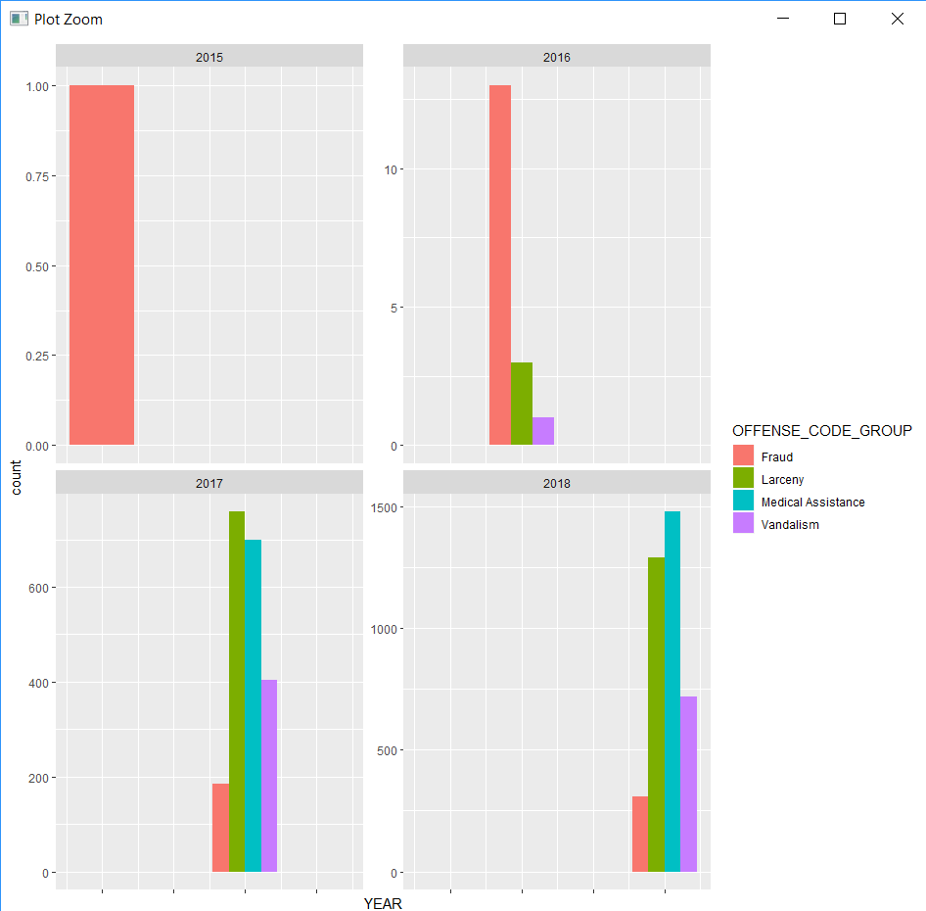
Bar Charts
Example 2 – con’t
position attribute changes chart type
  Default → stacked chart
  Dodge → grouped chart
    geom_bar(mapping = aes(x=YEAR,
    fill = OFFENSE_CODE_GROUP),
    position = "dodge")

Slide 37
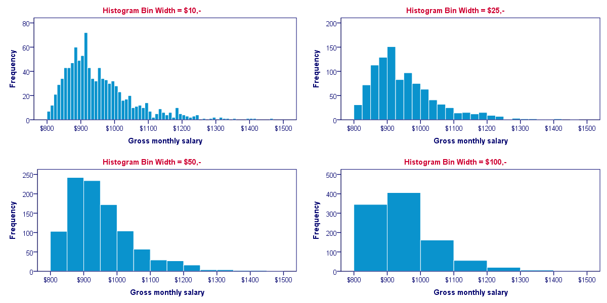
Histograms
ONE CONTINUOUS
geom_histogram
  Frequency of data in successive numerical intervals → BINS
  Aesthetics
    x → arithmetic scale
    y → count (automatic)
    fill → choose variable to fill
    binwidth = n → sets width of each bin
    binwidth = 10 → 0-10, 10-20, 20-30, etc.

Slide 38
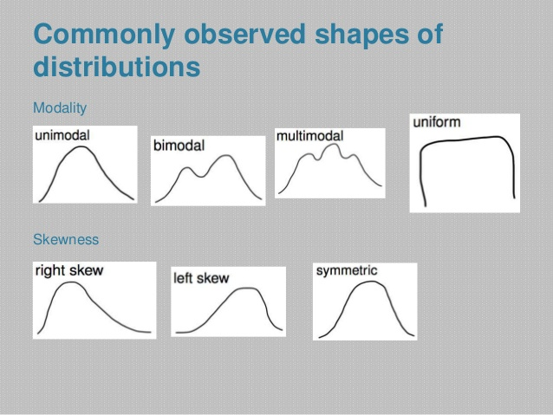
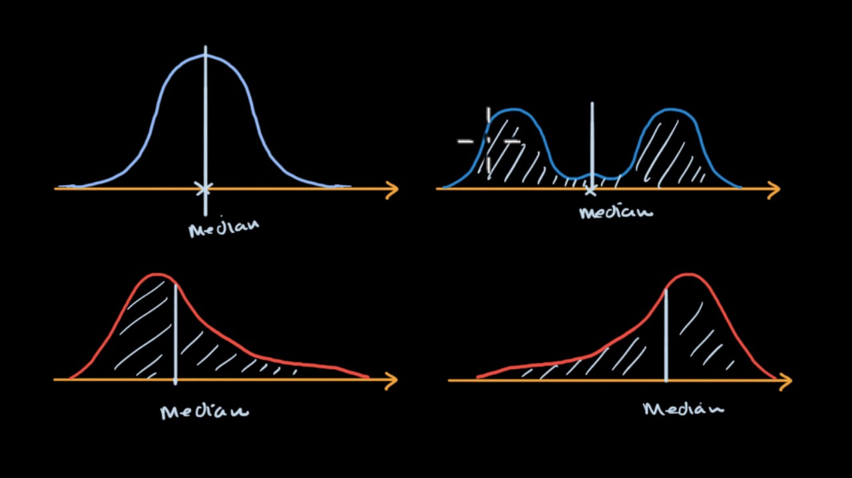
Histograms
Normal Distribution: Mean = Median
Right-Skewed: Mean > Median
Left-Skewed: Mean < Median

Slide 39
Distribution
Which is expected to be uniformly distributed?
  Daily temperature in Oxford
  Salaries of a random sample of Oxonians
  House prices
  Month of birthdays of Ole Miss students

Slide 40
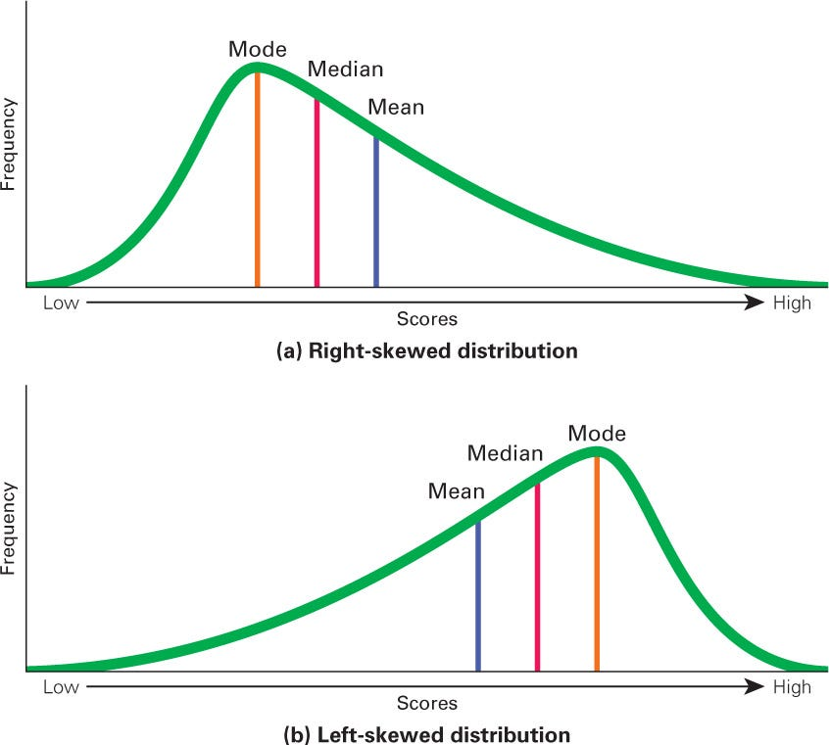
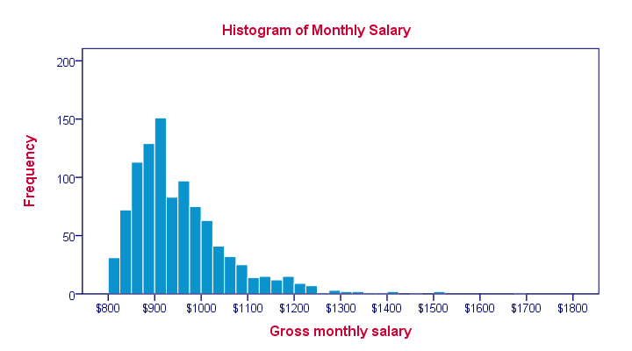
Mean v. Median
What can be said about the mean relative to median?
  Mean = Median
  Mean < Median
  Mean > Median
  Cannot tell

Slide 41
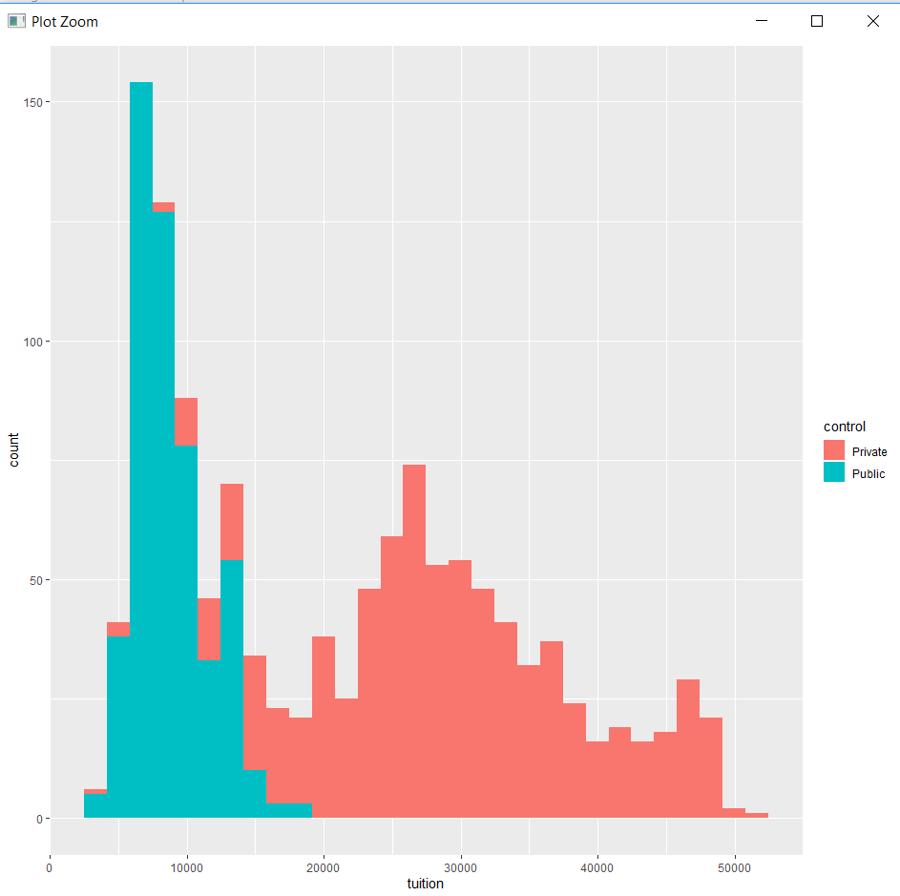
Histograms – Example 1
  college %>%
  ggplot() +
  geom_histogram(mapping =
  aes(x = tuition,
  fill = control))

Slide 42
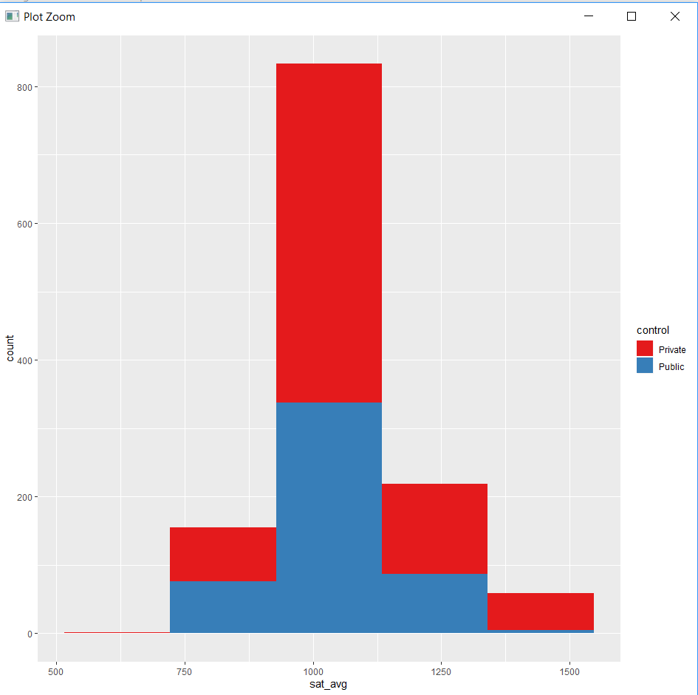
Histogram – Example 2
Designate 5 bins
  college %>%
  ggplot() +
  geom_histogram(mapping =
  aes(x = sat_avg,
  fill = control),
  bins = 5) +
  scale_fill_brewer(palette = "Set1")

Slide 43
When to use What Chart
Analyzing Trends → Line or Column Charts
Demonstrating Composition → Stacked Chart or Maps
Comparing Two or More Sets of Values → Scatterplot or Line (Continuous)
Understanding Data Distribution → Bar or Column (Discrete); Scatterplot or Line (Continuous)
When timeline is a factor → Bar Chart
https://blog.hubspot.com/marketing/types-of-graphs-for-data-visualization

